Slide 1
The Data Delusion
NEIL LAWRENCE
UNIVERSITY OF SHEFFIELD
Notes:
Challenges
Introduce self
Alphago impressive but requires heavy compute.
More games of go than any human
And yet still Lee managed to win a match.

Slide 2
GLOBAL INFORMATION STORAGE CAPACITY IN OPTIMALLY COMPRESSED BYTES
Notes:
Superhuman performances are being driven by ML
Vision, Speech, Translation
Lots of process, but driven by availability of data.
Methodologies have not progressed a great deal since late 1990s

Slide 3
Notes:
Historical Analogy
Thomas Newcomen South West England
1712 Steam Engine

Slide 4
Coal
Google
Facebook
Amazon
Tin
Startups

Slide 5
Notes:
People and entire fields are passed by.

Slide 6
Notes:
James Watt Separate Condensor 1760s

Slide 7
Outline of the DeepFace architecture. A front-end of a single convolution-pooling-convolution filtering on the rectified input, followed by three locally-connected layers and two fully-connected layers. Color illustrates feature maps produced at each layer. The net includes more than 120 million parameters, where more than 95% come from the local and fully connected layers.
Notes:
Modern Inference Engine
120 million parameters, 1 billion images, near human performance

Slide 8
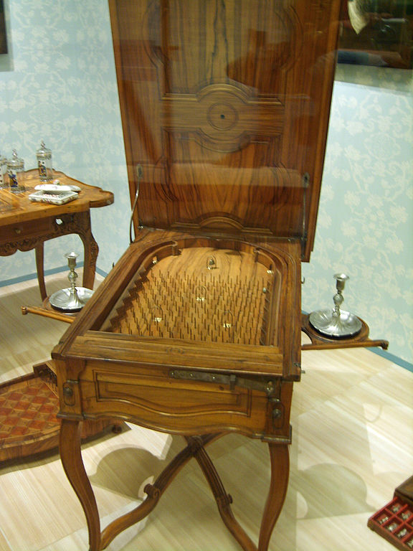
Notes:
Internal structure of the machine like layers of pins
Initial state of machine.
Moving pins around to fix

Slide 9
B
A
Notes:
All possible paths!

Slide 10



$f(x)$
$$\int{f\left(x\right)p\left(x\right)dx}$$
$$\frac{df(x)}{dx}$$

Slide 11

$$A=U−TS$$
Notes:
Helmholtz free energy
Simple formula
Complexity reduced
Need equivalent theory for ML

Slide 12
Thank you
Oren Etzioni
allenai.org
Neil Lawrence
@lawrennd
Notes:
Thank you.

